Slide 1
Easeometer
By Ryan Maynard

Slide 2

Proposal
New tech is catered to users with technological background.
Health awareness is more popular than ever. Tech and wearables more common.
provides the aging and not so tech savvy population a simple and robust tool.

Slide 3
Budget
Part | Price | Shipping | Quantity | Subtotal
Humber Parts Kit | $109.99 | N/A | 1 | $109.99
Raspberry Pi 3 | $55.99 | Free | 1 | $55.99
32GB SD Card | $14.50 | Free | 1 | $14.50
LSM303 Sensor | $29.99 | $13.00 | 1 | $41.99
HDMI Cable | $7.16 | Free | 1 | $7.16
GPIO add-ons | $15.99 | Free | 1 | $15.99
SD Card Reader | $10.99 | Free | 1 | $10.99
Total |  |  |  | $256.61

Slide 4
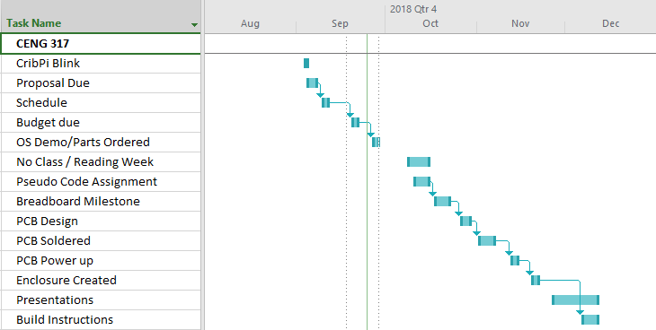
Schedule

Slide 5
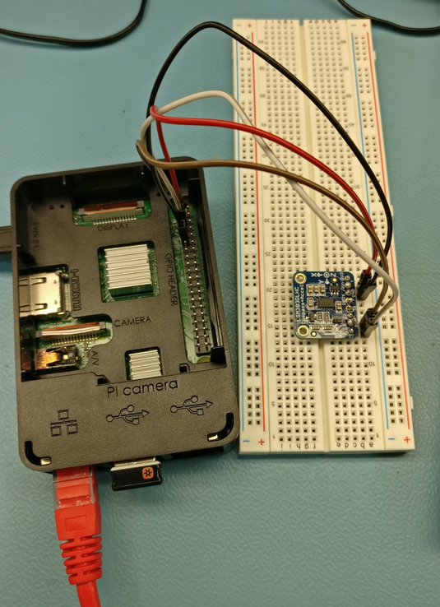
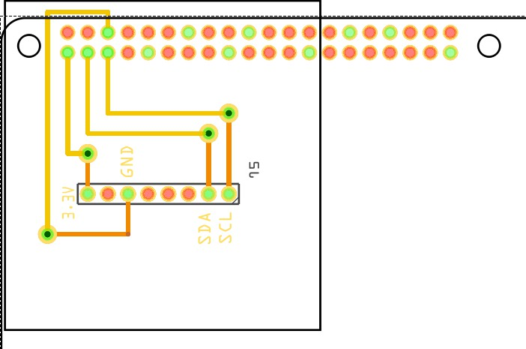
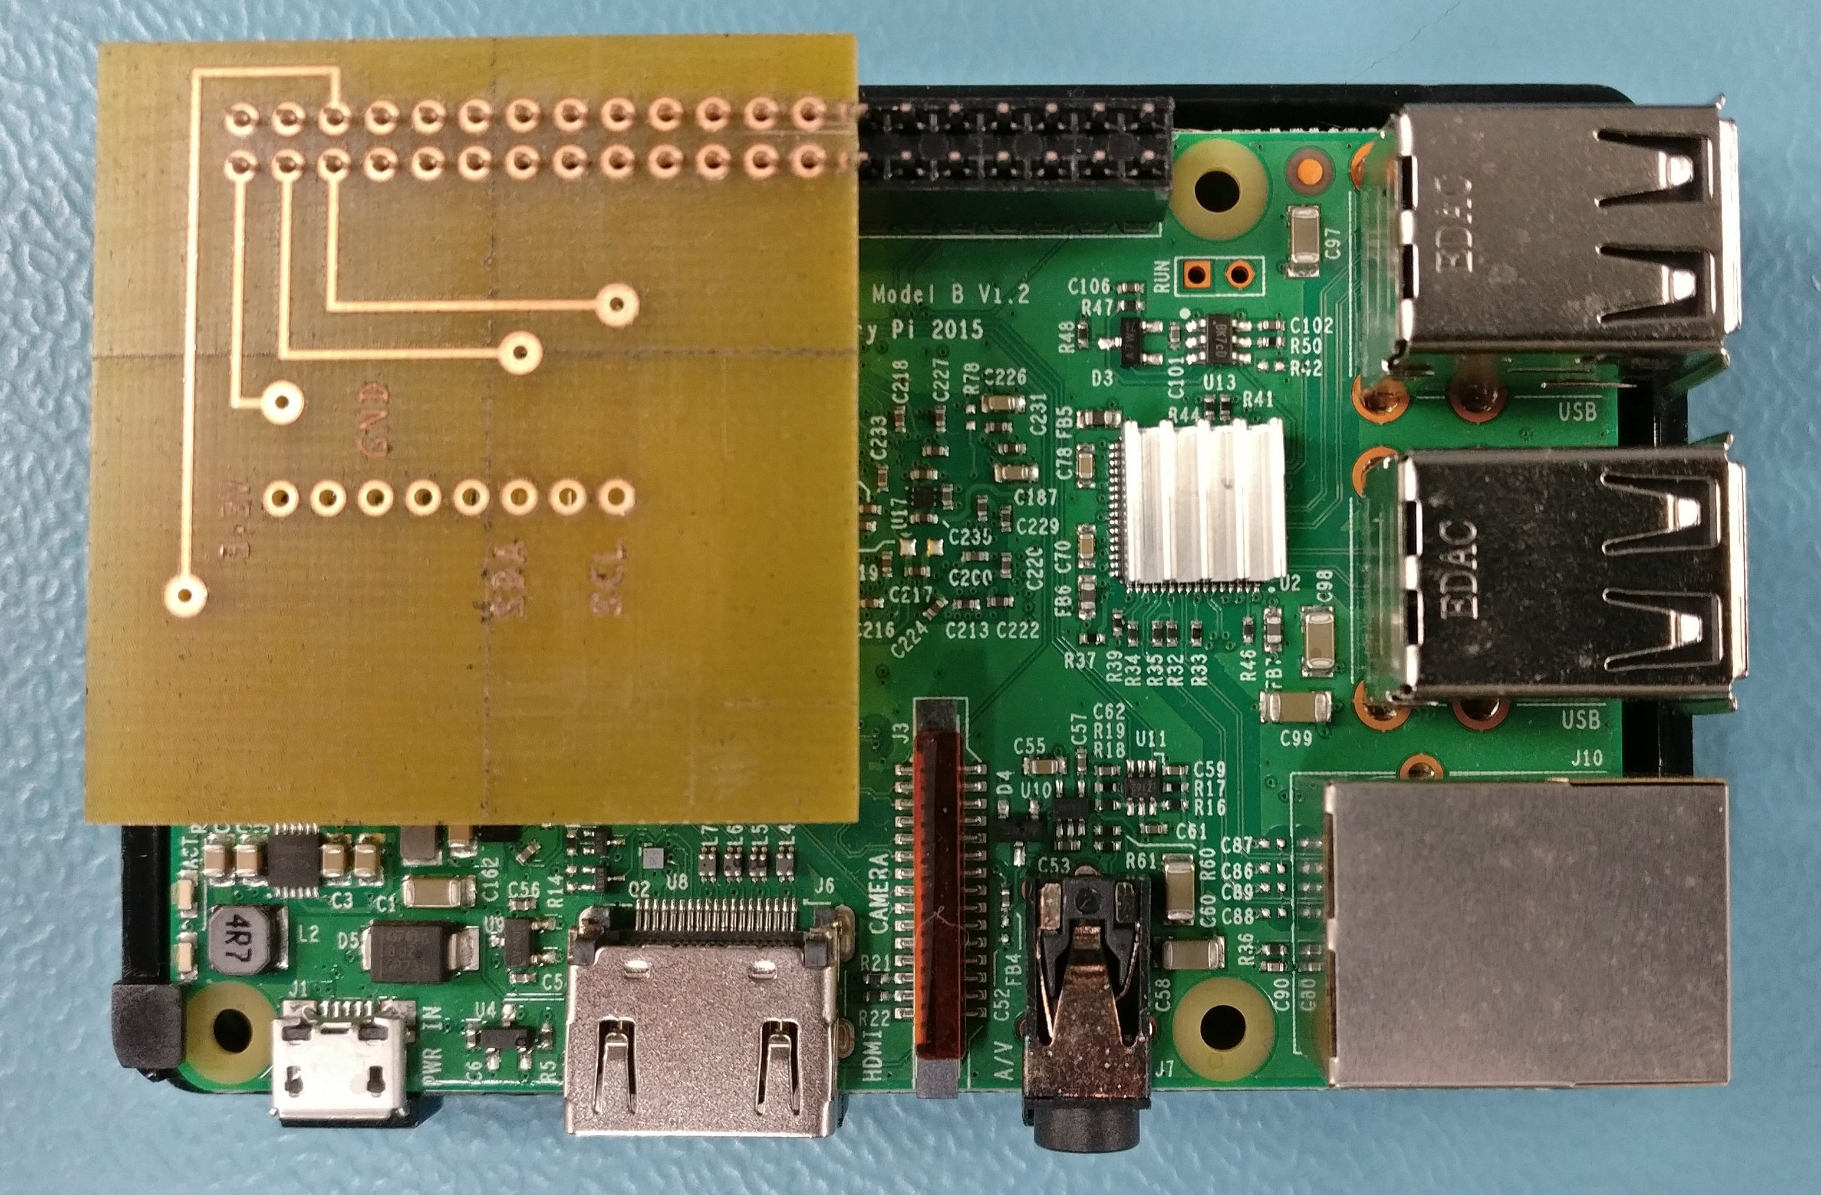
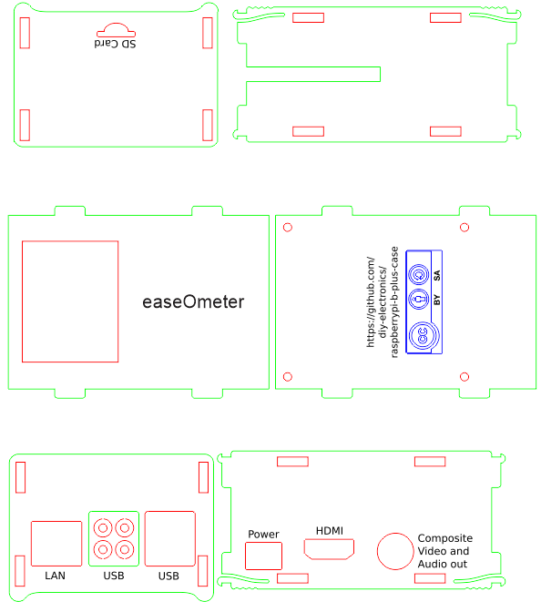
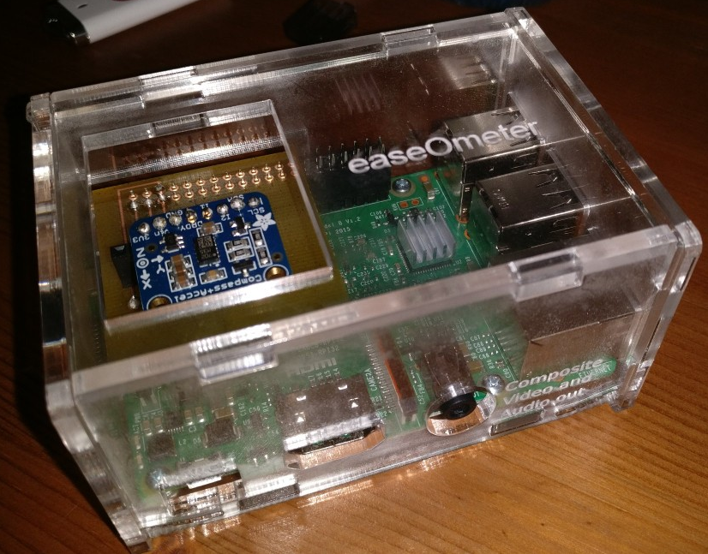
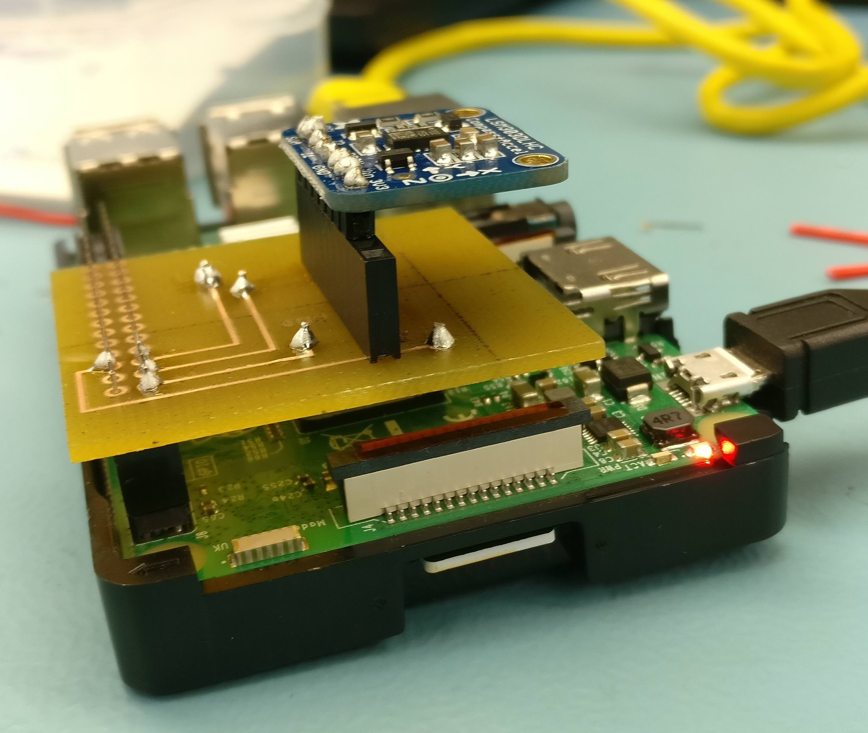

Slide 6
Knowledge from previous courses
TECH 101 – Learning to breadboard/Basic electrical concepts
TECH 153 – Working with hardware
WRIT 220 – Technical Writing
CENG 200 – Unix/Linux Basics
CENG 252 – Embedded System

